Slide 1
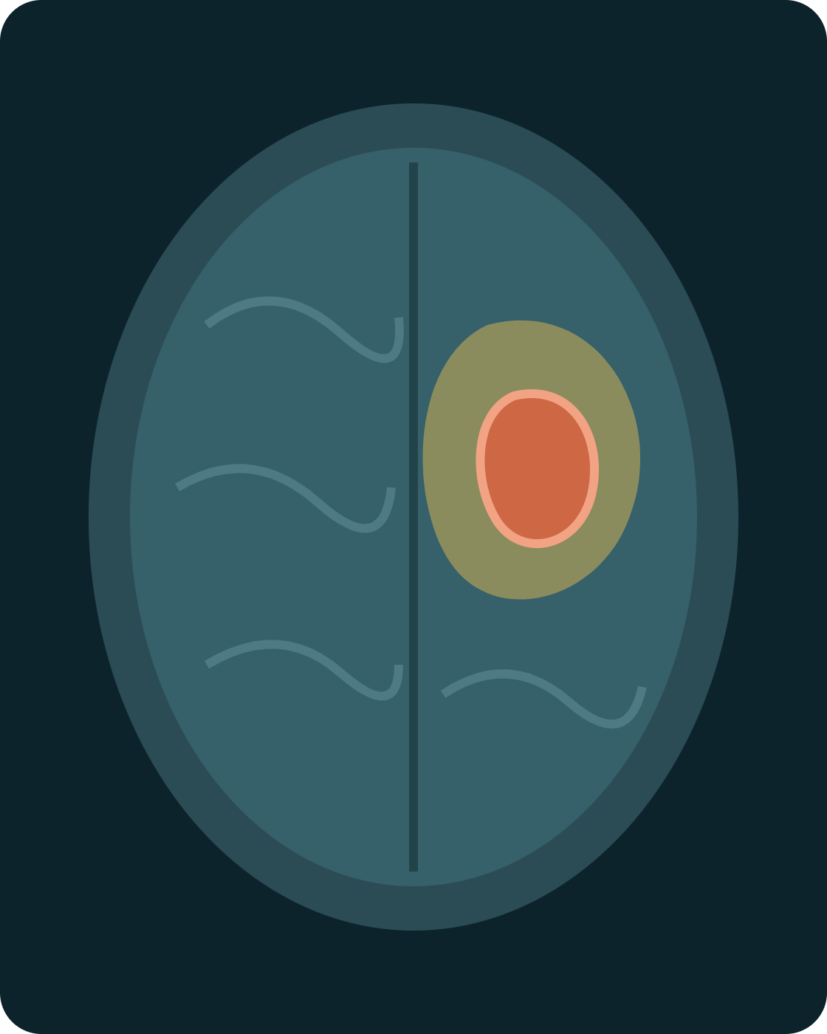
CSEG3060 · RESEARCH METHODOLOGY IN COMPUTER SCIENCE
UNIT III · PART 1
Literature Search Strategies
How to find the right papers, fast, worked through one real example: problem: brain tumour segmentation in MRI.
Dr. Mohsin Furkh Dar · School of Computer Science, UPES
Notes:
Unit III has four parts. Today is Part 1: how to find literature systematically. We will use one running example throughout: segmenting brain tumours in MRI scans.

Slide 2
SESSION GOALS
By the end of this session, you can…
01
Tell primary from secondary sources, and know which to read first
02
Build a Boolean query that finds relevant papers and filters out noise
03
Choose the right databases for your topic
04
Use backward and forward citation chaining from one strong paper
05
Keep a search log that makes your review reproducible
CSEG3060 · Unit III · Part 1 — Literature Search Strategies

Slide 3
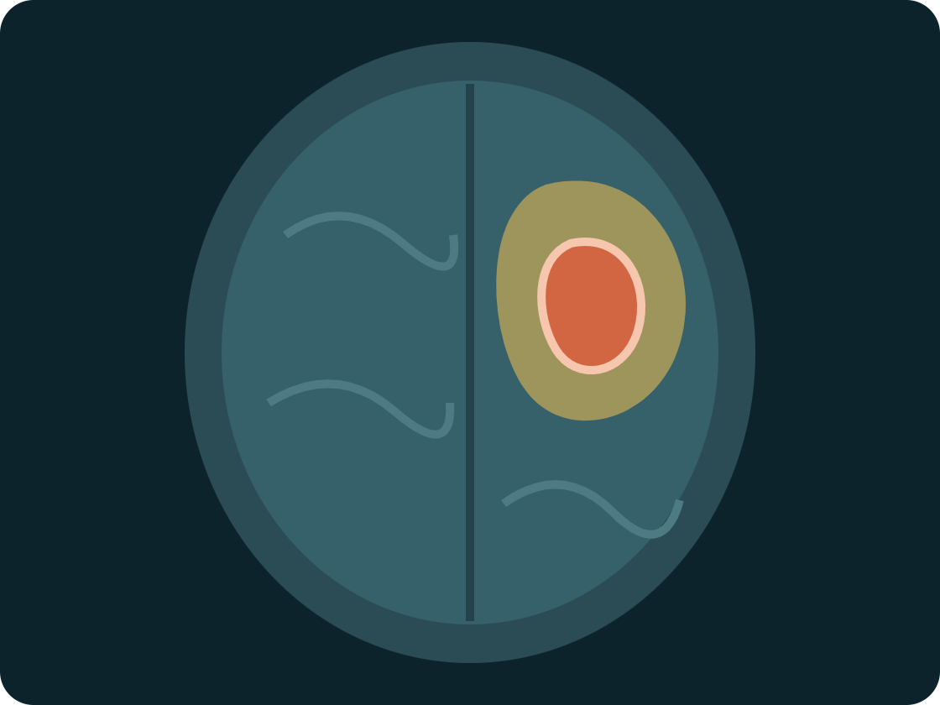
RUNNING EXAMPLE
Student ‘X’ wants to “use AI to find brain tumours in MRI”
Classification vs. segmentation
Classification answers one question: is there a tumour? Segmentation goes further. It labels every pixel as tumour or healthy tissue, drawing the tumour’s exact boundary.
That boundary matters clinically: measuring tumour volume, planning surgery and tracking response to treatment.
Public benchmark: the BraTS challenge (Menze et al., IEEE TMI 2015) provides MRI scans with expert-labelled tumour sub-regions.
■ Whole tumour (including oedema)
■ Tumour core
□ Enhancing tumour rim
CSEG3060 · Unit III · Part 1 — Literature Search Strategies
Notes:
Priya is our running student. Her idea is vague, and her first instinct is to Google it. Everything today is about replacing that instinct with a method. The illustration is schematic, not a real scan.

Slide 4
THE PLAN FOR TODAY
A search engine returns a flood of results. A search strategy returns the papers you need.
A
B
C
D
E
Sources
Boolean queries
Databases
Citation chaining
Search log
Primary vs. secondary
Precise searches
Where to search
Make it reproducible
Papers find papers
Notes:
Ask the class: who has typed their topic into Google and scrolled through pages of results? That is what we are replacing. Five tools, in this order.

Slide 5
A · SOURCES
Primary sources report. Secondary sources review.
Type | Brain-segmentation example | What it gives
Primary | Ronneberger et al., “U-Net”, MICCAI 2015 | The exact architecture, training setup and results, first-hand
Primary (dataset) | Menze et al., “The BraTS benchmark”, IEEE TMI 2015 | How the MRI scans were collected and labelled
Secondary | Litjens et al., survey of deep learning in medical image analysis, Medical Image Analysis 2017 | A map of methods, tasks, datasets and open problems
Secondary | Siddique et al., review of U-Net and its variants, IEEE Access 2021 | How U-Net evolved and which variant suits which task
CSEG3060 · Unit III · Part 1 — Literature Search Strategies
Notes:
Primary: the original paper where a method or dataset was first proposed and tested. Secondary: surveys and reviews that summarise and compare many primary papers. A dataset paper like BraTS is also primary.

Slide 6

A · SOURCES
Read the map before the territory
STEP 1 · SECONDARY FIRST
STEP 2 · PRIMARY NEXT
Read one good survey
Go deep on key papers
Main method families
Benchmark datasets and metrics
Open problems named by experts
The key papers to read next
Exact architecture and loss
Data, pre-processing, splits
Results and their conditions
Limitations surveys skip
Common mistake: quoting U-Net’s results from a survey without reading U-Net itself. Cite what you have actually read.
CSEG3060 · Unit III · Part 1 — Literature Search Strategies
Notes:
For Priya, the Litjens survey tells her that U-Net-style encoder–decoders dominate, that BraTS is the standard benchmark, and that Dice score and Hausdorff distance are the usual metrics. Only then does she open U-Net itself.

Slide 7
B · BOOLEAN QUERIES
Six operators do most of the work
Operator | What it does | Example
AND | Both terms must appear: narrows | segmentation AND MRI
OR | Either term (synonyms): broadens | glioma OR "brain tumor"
NOT | Removes a term: use sparingly | NOT "computed tomography"
" " | Exact phrase | "deep learning"
* | Truncation: any word ending | segment* → segmentation, segmented
( ) | Groups terms, like brackets in maths | (U-Net OR transformer) AND MRI
Rule of thumb: OR inside a concept, AND between concepts.
CSEG3060 · Unit III · Part 1 — Literature Search Strategies

Slide 8
B · BOOLEAN QUERIES
Query contains one concept per line
("brain tumor" OR "brain tumour" OR glioma)
The problem. US and UK spellings, plus the clinical term.
AND segment*
The task. Matches segmentation, segmenting, segmented.
AND (MRI OR "magnetic resonance")
The modality. Abbreviation and full form.
AND ("deep learning" OR CNN OR U-Net OR transformer)
The method family.
NOT ("computed tomography" OR CT)
Out of scope. Check that no good papers were lost.
Tip: add one line at a time and watch the result count. Each AND should shrink it; each OR should grow it.
CSEG3060 · Unit III · Part 1 — Literature Search Strategies
Notes:
Live demo idea: run the query on IEEE Xplore adding one line at a time and write the result counts on the board. Point out that forgetting the UK spelling "tumour" silently drops papers.

Slide 9
B · BOOLEAN QUERIES
Same idea, different syntax in each database
IEEE Xplore
PubMed
Google Scholar
Command Search accepts AND, OR, NOT, quotes and *. You can restrict each term to the title or abstract.
Use MeSH, PubMed’s controlled vocabulary, so every synonym for a disease is caught automatically.
Brackets and NOT are unreliable. Exclude terms with a minus sign; use allintitle: to search titles only.
("Abstract":glioma) AND ("Abstract":segment*)
"Brain Neoplasms"[MeSH] AND segmentation[tiab]
glioma segmentation MRI -"computed tomography"
CSEG3060 · Unit III · Part 1 — Literature Search Strategies
Notes:
[tiab] in PubMed means title or abstract. MeSH is a big advantage for medical topics: "Brain Neoplasms" covers glioma, glioblastoma, meningioma and more without listing them all.

Slide 10
C · DATABASES
Where to search for computing research
Database | Best for | Watch out for
IEEE Xplore | IEEE TMI, ISBI, engineering venues | Paywalled: use UPES library access
ACM Digital Library | Computing venues, systems papers | Fewer medical-imaging papers
PubMed | Clinical and biomedical literature | Weak on CS conferences
Google Scholar | Widest coverage, “Cited by” links | Mixes in low-quality venues
arXiv (cs.CV, eess.IV) | Newest work, before publication | Not peer-reviewed
Scopus / Web of Science | Curated indexing, citation metrics | Subscription needed
For an interdisciplinary topic, search at least one computing database and one biomedical database.
CSEG3060 · Unit III · Part 1 — Literature Search Strategies
Notes:
Medical image segmentation sits between computer science and medicine. IEEE Xplore alone misses clinical validation studies; PubMed alone misses most method papers. Priya needs both.

Slide 11
C · DATABASES
Know where the field publishes
CONFERENCES
JOURNALS
HIGH-IMPACT SCIENCE
MICCAI · ISBI · MIDL · CVPR · NeurIPS
IEEE TMI · Medical Image Analysis
Nature Methods · Nature Comms
Where most new methods first appear. MICCAI is the flagship; U-Net was published there.
Extended, carefully reviewed versions of methods and benchmarks.
Field-changing tools: nnU-Net (Nature Methods, 2021) and MedSAM (Nature Communications, 2024).
Rule: a peer-reviewed paper outranks a preprint. Found it on arXiv? Check for a published version and cite that.
CSEG3060 · Unit III · Part 1 — Literature Search Strategies

Slide 12

D · CITATION CHAINING
One strong paper leads you to many more
FORWARD · “CITED BY” ▶
◀ BACKWARD · ITS REFERENCES
3D U-Net (2016)
SEED PAPER
Çiçek et al. · full 3D volumes
Cireşan et al., NIPS 2012
U-Net
Deep networks label microscopy images pixel by pixel
Attention U-Net (2018)
Ronneberger et al., MICCAI 2015
Oktay et al. · focuses on key regions
Long et al., CVPR 2015
Encoder–decoder with skip connections; trains well on few images
nnU-Net (2021)
Fully convolutional networks: whole image in, label map out
Isensee et al. · self-configuring
Swin UNETR (2022)
Hatamizadeh et al. · brain tumours
CSEG3060 · Unit III · Part 1 — Literature Search Strategies
Notes:
Backward chaining shows how the idea was born; forward chaining shows where it went next. From one seed, Priya found the 3D, attention-based, self-configuring and transformer branches of the family, ending at Swin UNETR, which was evaluated on brain tumour data.

Slide 13
D · CITATION CHAINING
Taming a paper with thousands of citations
1
2
3
Open the seed
Search within
Narrow it
On Google Scholar, find U-Net and click Cited by.
Tick “Search within citing articles” under the search box.
Type glioma OR BraTS. You now see only papers that build on U-Net and study brain tumours.
Visual tools
When to stop
Semantic Scholar and Connected Papers draw citation networks, so clusters of related work stand out.
At saturation: when new searches keep returning papers you already have.
CSEG3060 · Unit III · Part 1 — Literature Search Strategies
Notes:
Forward chaining from a hugely cited paper is useless without filtering. The "Search within citing articles" checkbox is the single most useful trick in Google Scholar. Demonstrate it live if possible.

Slide 14
E · SEARCH LOG
Log every search so others can repeat it
Date | Database | Query or method | Found | Kept | Note
[date] | IEEE Xplore | Query v2, title + abstract, 2019–2026 | [__] | [__] | Journals and conferences
[date] | PubMed | MeSH query, English only | [__] | [__] | Clinical validation studies
[date] | Google Scholar | Cited by U-Net + “glioma OR BraTS” | [__] | [__] | Found Swin UNETR
[date] | arXiv | cs.CV and eess.IV, last 12 months | [__] | [__] | Check published versions
Transparent: your supervisor can check your coverage
Repeatable: rerun the same search months later
Required: systematic reviews report it (PRISMA)
CSEG3060 · Unit III · Part 1 — Literature Search Strategies
Notes:
The counts are left blank on purpose: have students fill them in during the activity. PRISMA is the reporting guideline for systematic reviews; its flow diagram is built directly from a search log like this.

Slide 15

PUTTING IT TOGETHER
Search workflow
1
2
3
4
5
Survey first
Boolean query
Two worlds
Chain
Log
A review gives the map
One concept per line
IEEE Xplore + PubMed
Back and forward from U-Net
Every search, every count
The result: a focused, defensible reading list, ready for Part 2: analysis and synthesis.
CSEG3060 · Unit III · Part 1 — Literature Search Strategies

Slide 16
TRY IT · 20 MINUTES
Your turn: Based on your selected problem
Pick one topic
Then do this
Polyp segmentation in colonoscopy
Retinal vessel segmentation
Skin lesion segmentation
Lung segmentation in chest X-rays
Find one survey paper on your topic
Write a Boolean query with an OR group and a NOT
Run it on IEEE Xplore and PubMed; compare the top 10
Chain one seed paper: 2 backward, 2 forward
Record every search in a log
Notes:
Work in pairs. Collect one search log per pair at the end; it becomes the input for the Part 2 activity on analysis and synthesis.

Slide 17
KEY TAKEAWAYS
Four habits of a good literature search
1
Read a survey first, then the primary papers it points to.
2
OR joins synonyms, AND joins concepts, NOT is used sparingly.
3
For medical imaging, search one computing and one biomedical database.
4
Chain backward and forward from a strong seed paper, and log it all.
Next · Part 2: Literature analysis and synthesis, turning these papers into a research gap

